Slide 1
National Integrated Services Framework
2-3 December 2013
Dublin
Part 2

Slide 2
HSE DEMO
SAM editor
SAM Environment
SIA’s
1- Business requirements and Dataset
2- SAM editor introduction: constructing a SAM
3- The SAM editor - life DEMO
4- Semantic Interoperability Artefacts (SIA’s)
5- SAM/SIA Environment -
Governance of Document artefacts and Concept artefacts

Slide 3
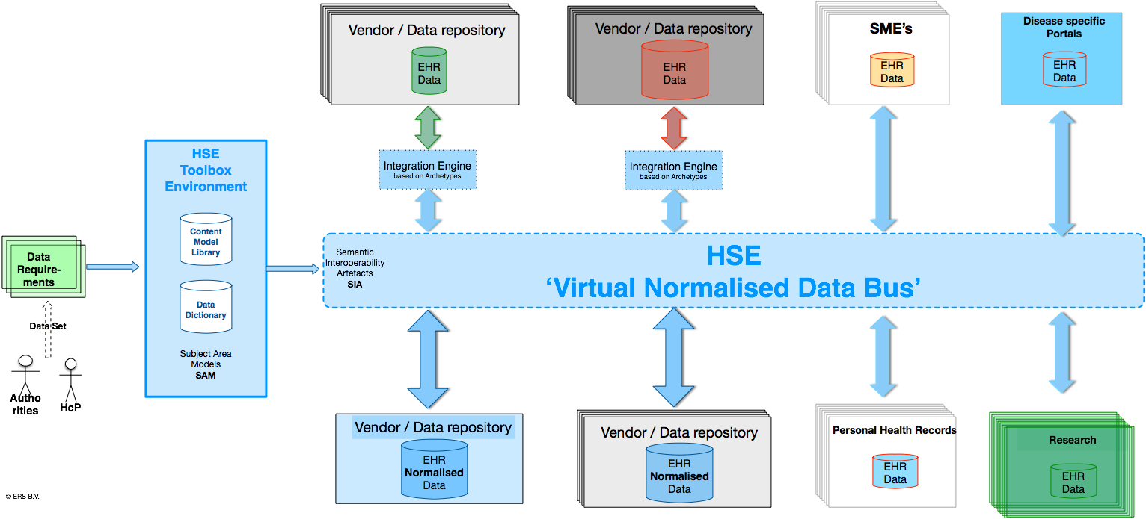
HSE
Tooling Environment
Tooling
Production
Governance
of SAM’s / SIA’s
SIA’s
expressing data needs
to be used by all

Slide 4
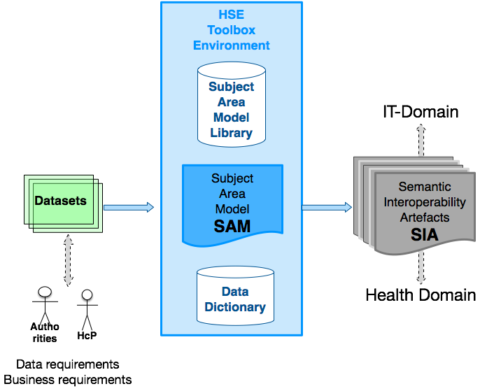
From ‘Information’ Requirements to Semantic Interoperability Artefacts

Slide 5
Business needs
Data needs
Stakeholders:
  Healthcare providers
  Health organisations
  Payers
  Authorities
  Research
Stakeholders have ‘information’ needs
Each for its own business needs

Slide 6

Datasets
‘Information’ needs
(Data needs)
are expressed as:
Datasets

Slide 7
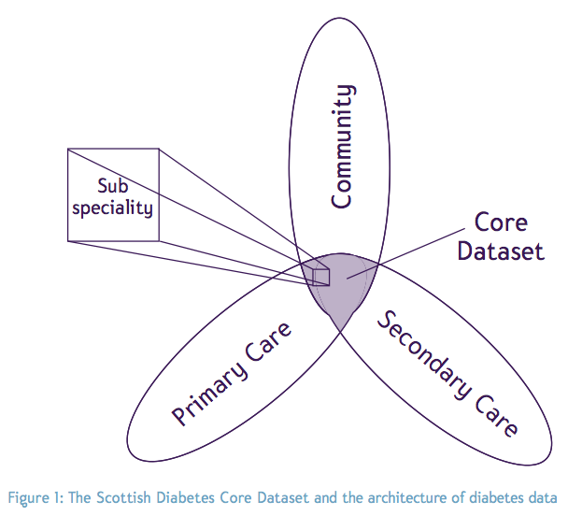
Datasets
Kinds of ...

Slide 8
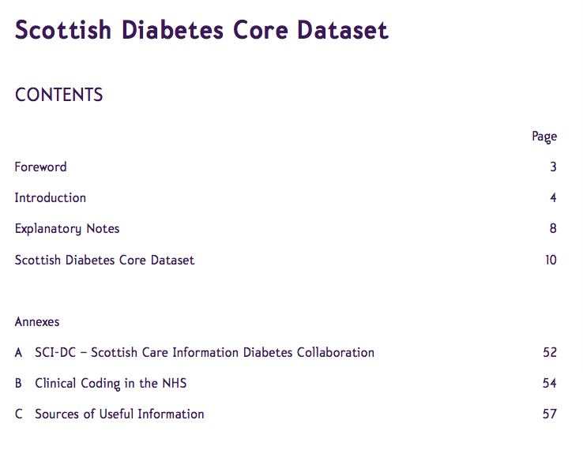
42 pages of tables

Slide 9
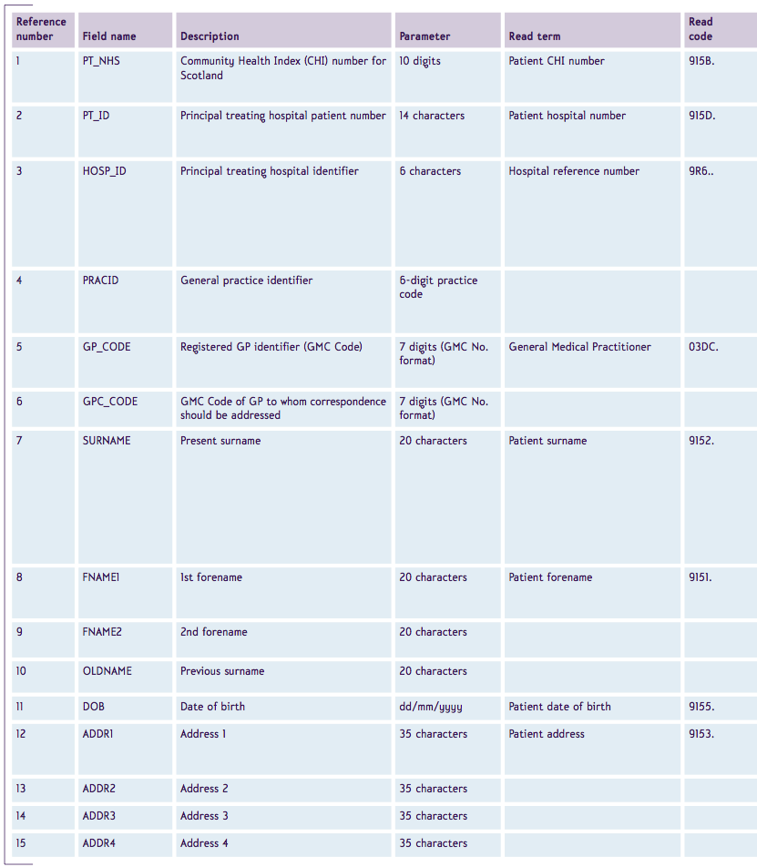
Dataset example

Slide 10
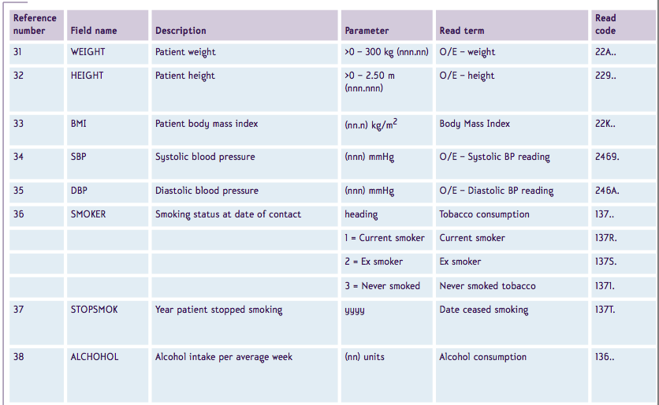
Dataset example

Slide 11
Dataset
Datasets:
  express the data needs of stakeholders
  can be used in procurement
  specify what IT-systems must be able to handle (store, retrieve, exchange)
  facilitate reporting, collaboration, and research

Slide 12
From ‘Information’ Requirements to Semantic Interoperability Artefacts

Slide 13
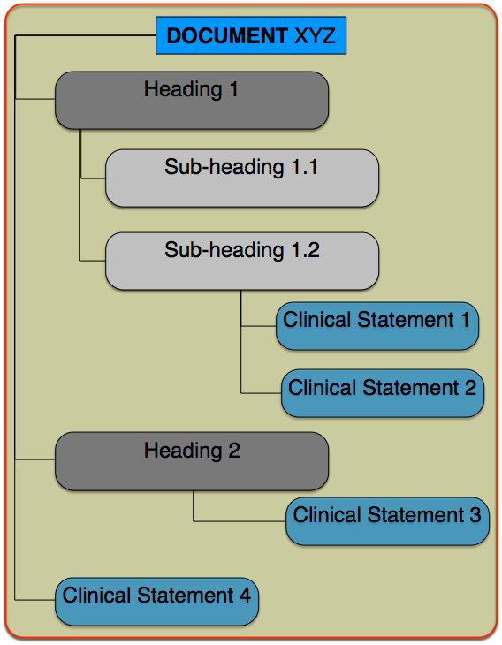
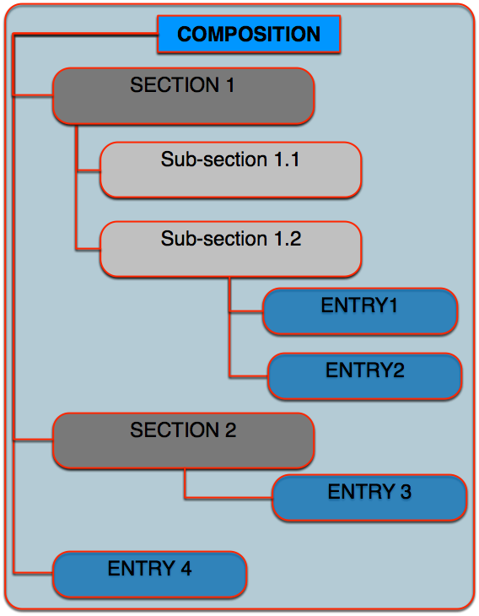
From Data Set to Subject Area Model
Any Document
Reference Model

Slide 14
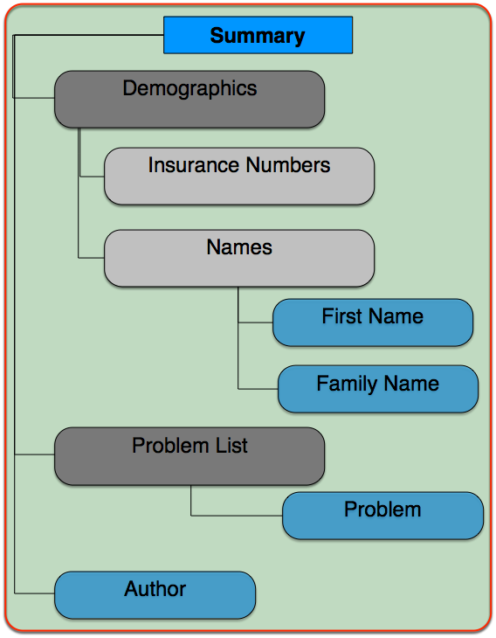
From Data Set to Subject Area Model
Reference Model
Subject AreaModel

Slide 15
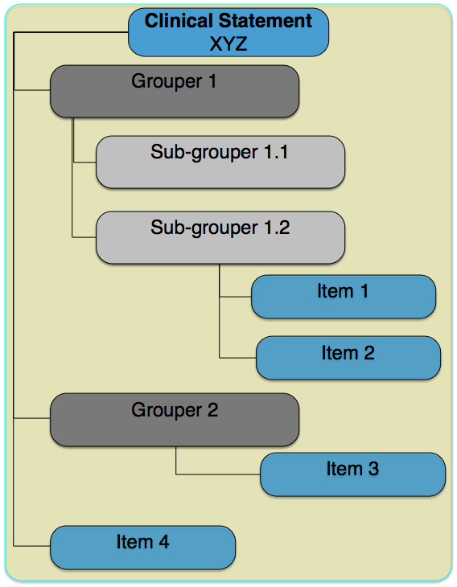
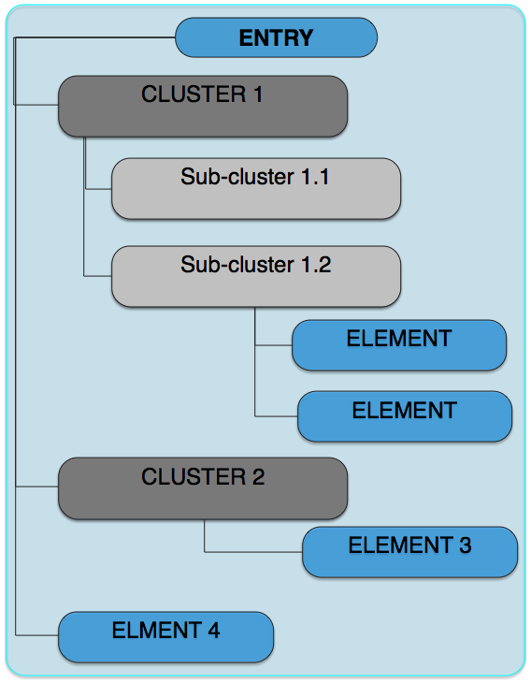
From Data Set to Subject Area Model
ClinicalStatementModel
ReferenceModel

Slide 16
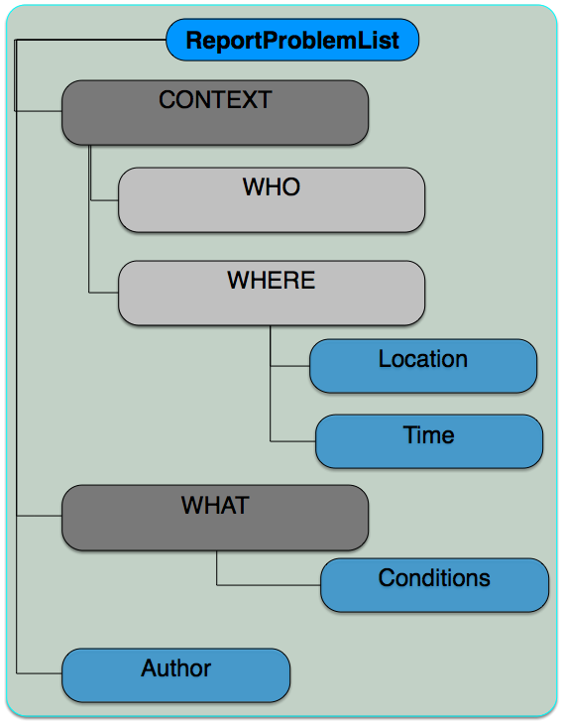
From Data Set to Subject Area Model
ReferenceModel
SubjectAreaModel

Slide 17
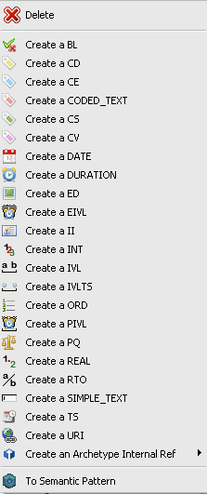
From Data Set to Subject Area Model
SubjectAreaModel
Data Types
Simple text
TS
CD
Simple text

Slide 18
From Data Set to Subject Area Model
Cardinalities
Occurrences
Codes
Annotations
Loinc: 1234
ContSys: Problem List
References/codes to existing systems
0-2
0-2
0-1
0-1
1-1
1-1
1-1
1-1
SNOMED: 123.234
Loinc: 4567
ContSys: HealthCondition
Any local or international code
1-…
1-…
1-1
1-1

Slide 19
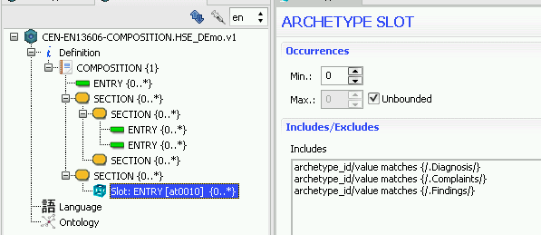
HSE Toolset
SAM Editor

Slide 20
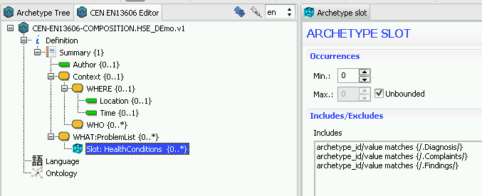
HSE Toolset
SAM Editor

Slide 21
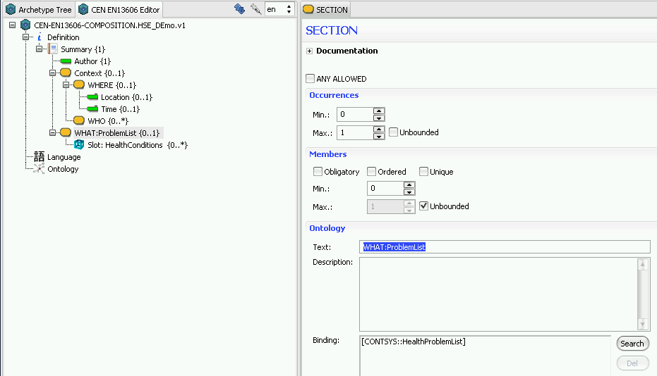
HSE Toolset
SAM Editor

Slide 22
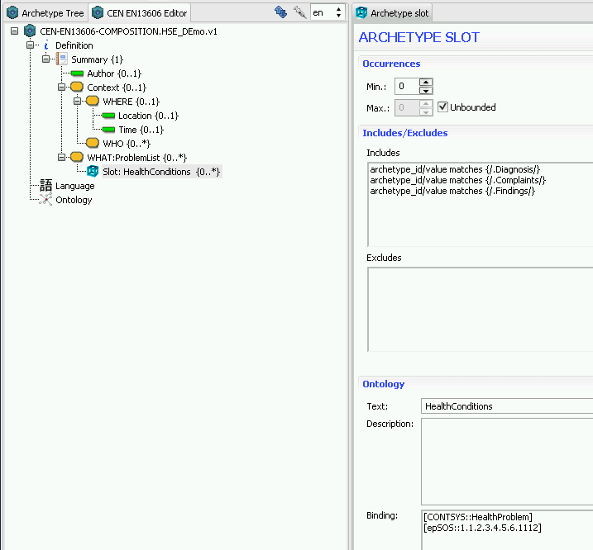
HSE Toolset
SAM Editor

Slide 23
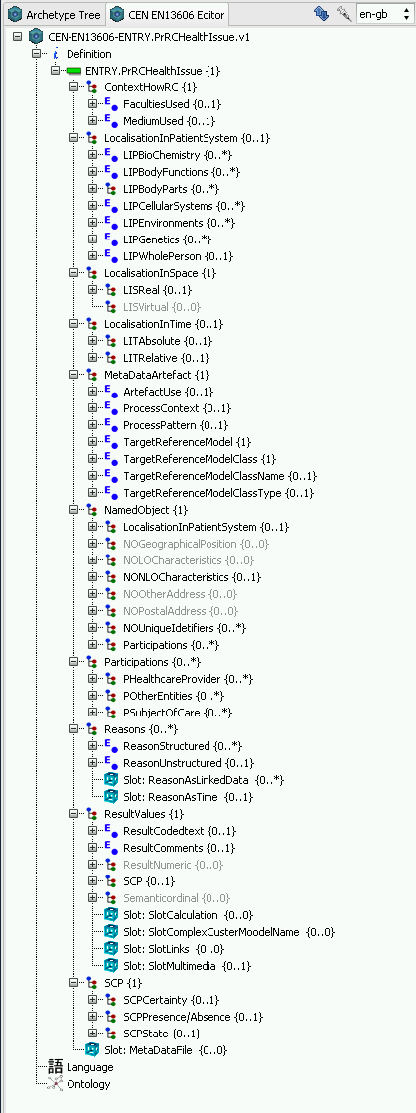
HSE Toolset
SAM Editor

Slide 24
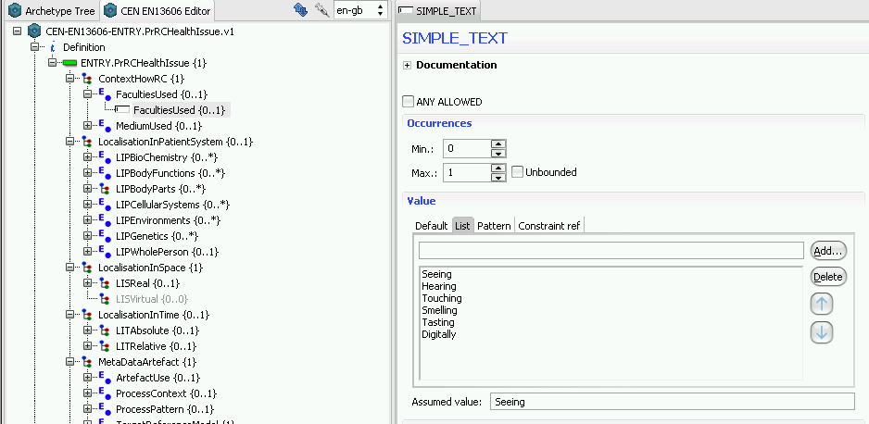
HSE Toolset
SAM Editor

Slide 25
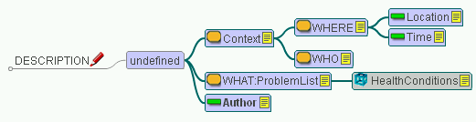
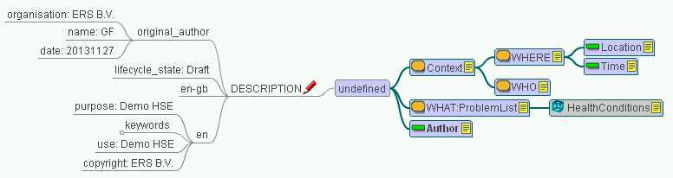
Mind Map

Slide 26
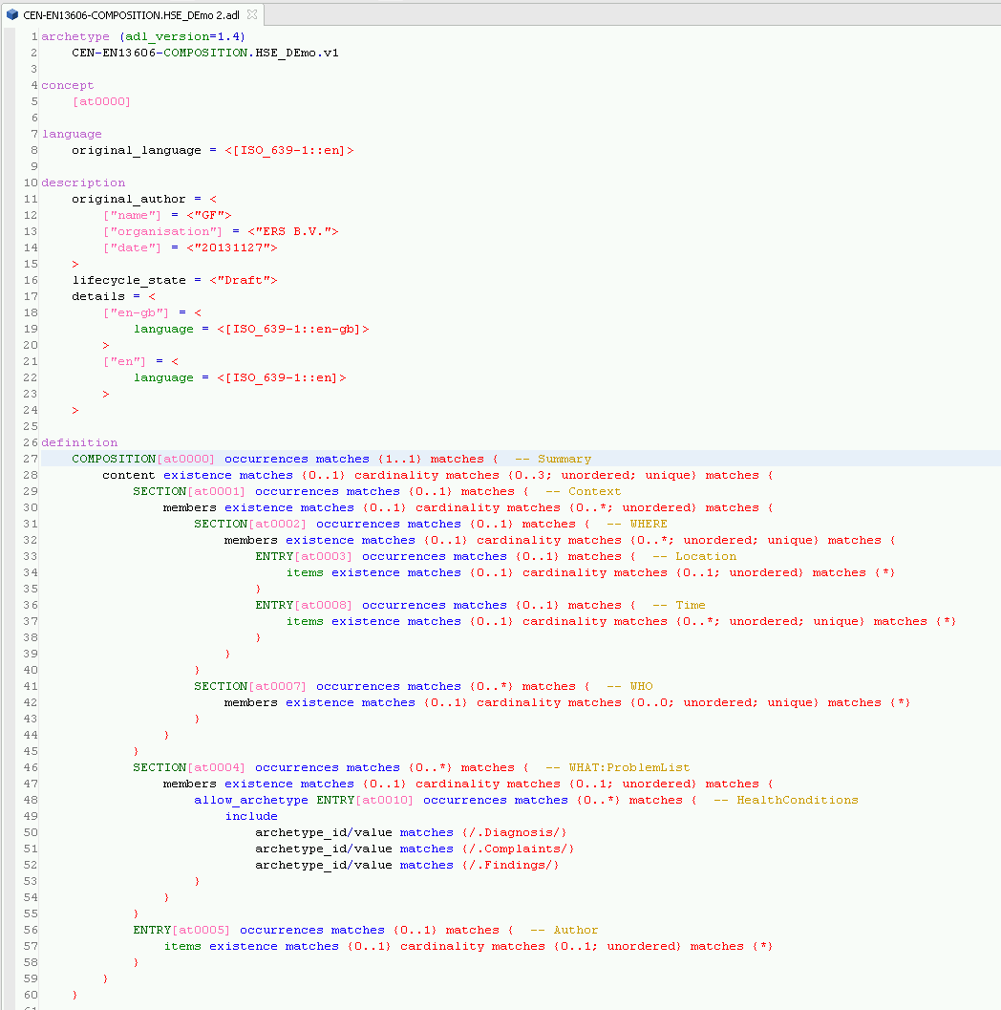
ADL

Slide 27
Conclusions
  Any Data Set can be converted into
  a precise standards based
  Subject Area Model (SAM),
  Semantic Interoperability Artefact (SIA)
  The SAM / SIA’s can be inspected by:
    Stakeholders in the Health knowledge domain
    (SAM Editor, Mind Map, HTML) and
    Stakeholders in the IT knowledge domain
    (ADL, XML Data instantiation)

Slide 28
Conclusions
  The HSE Tooling Framework
  the Subject Area Models (SAM’s)
  the Semantic Interoperability Artefacts (SIA’s)
  together with the codes and their mappings
  EMPOWER all STAKEHOLDERS

Slide 29
DEMO

Slide 30
Next time
Governance + tooling
Governance
of
Documents
Governance
of
Concepts
with
Codes

Slide 31
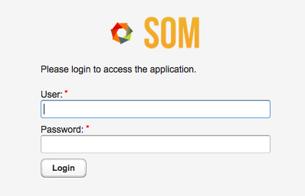
Governance: SAM/SIA Library
Semantic Object Manager

Slide 32
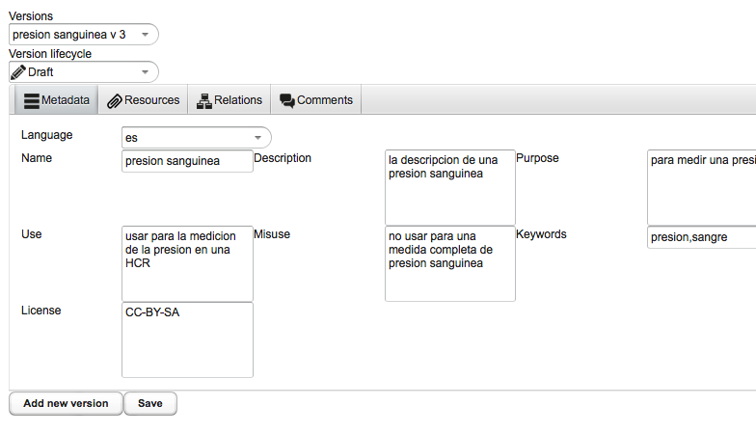
Governance: SAM/SIA Library

Slide 33
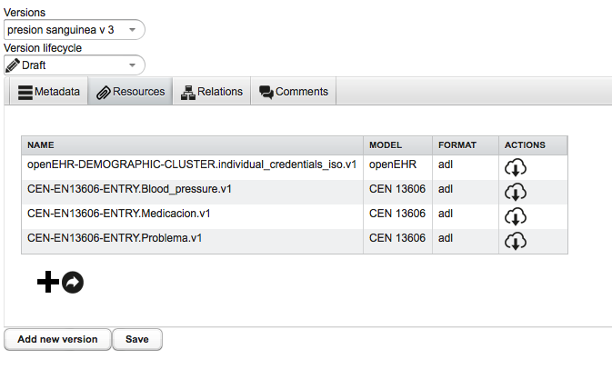
Governance: SAM/SIA Library

Slide 34
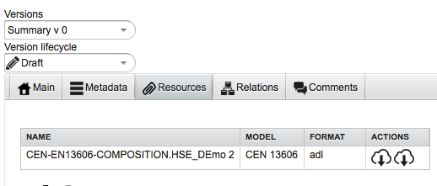
Governance: SAM/SIA Library

Slide 35
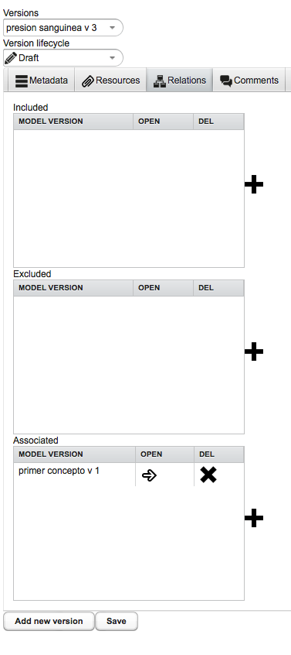
Governance: SAM/SIA Library

Slide 36
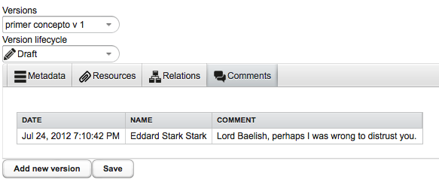
Governance: SAM/SIA Library

Slide 37
Next time
Governance + tooling
Governance
of
Documents
Governance
of
Concepts
and
Codes

Slide 38
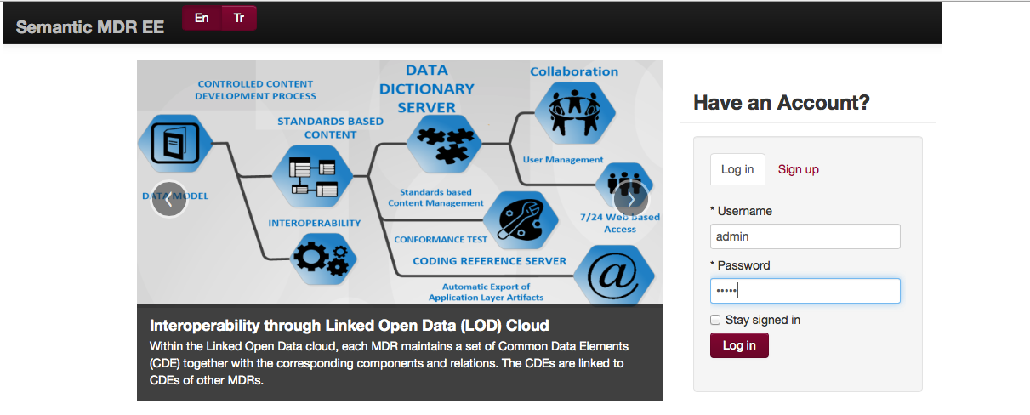
ISO 11179
Semantic MetaData Registry
Data Dictionary

Slide 39
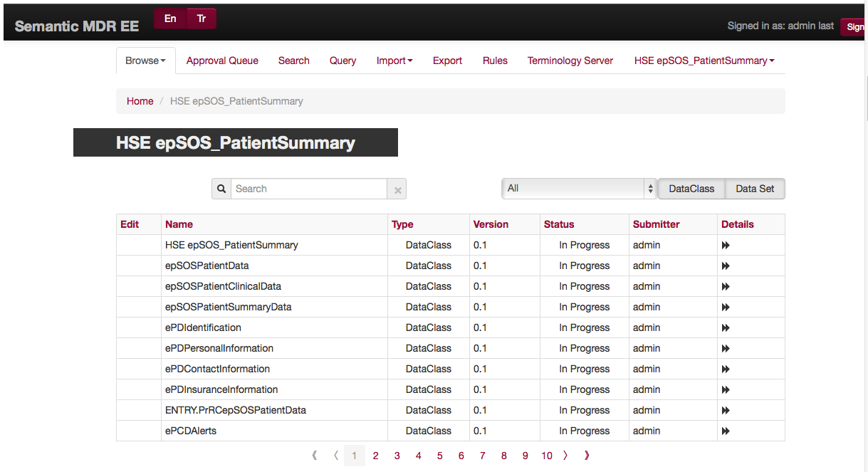
ISO 11179
Data Dictionary

Slide 40
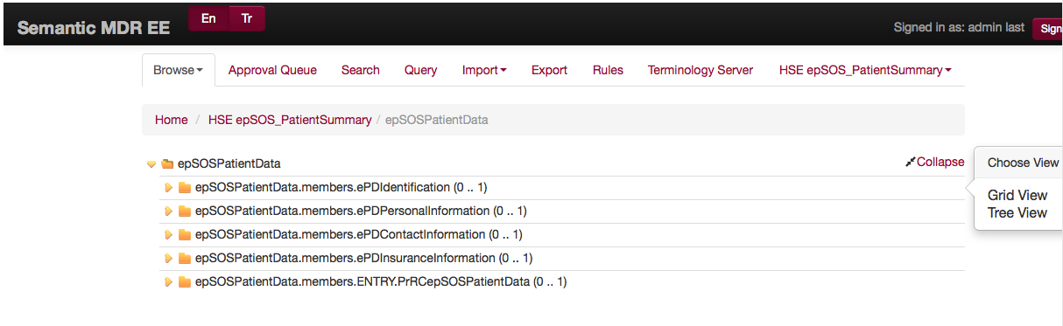
ISO 11179
Data Dictionary

Slide 41
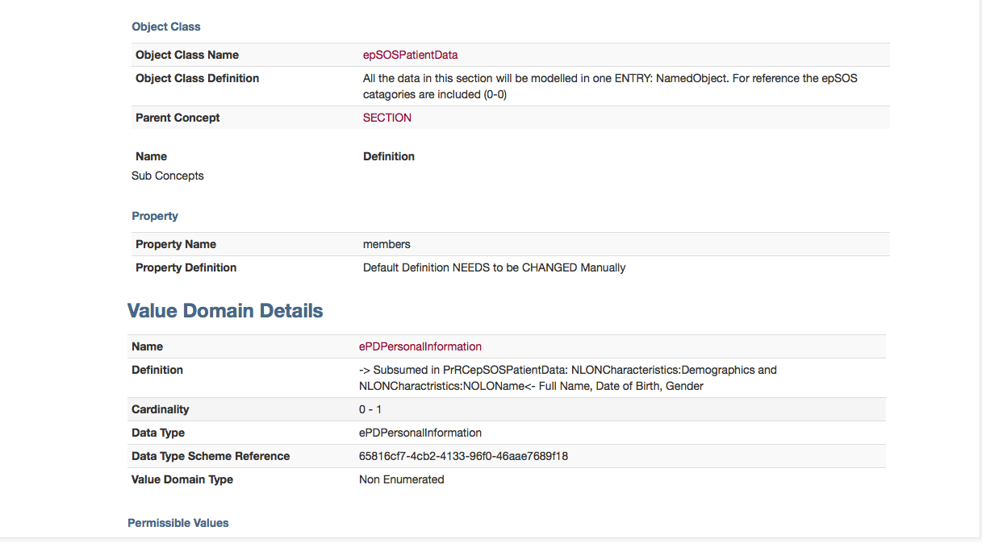
ISO 11179
Data Dictionary

Slide 42
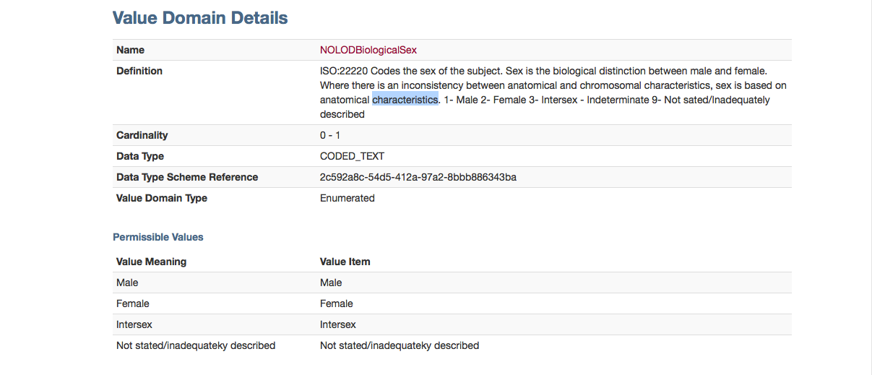
ISO 11179
Data Dictionary

Slide 43
DEMO

Slide 44
HSE
Tooling Environment
Tooling
Production
Governance
of SAM’s / SIA’s
SAM’s / SIA’s
expressing data needs
to be used by all

Slide 45
To be expected February 2014
The epSOS Patient Summary:
  Information Architecture Reference Model
  Subject Area Model
  Semantic Interoperability Artefacts + Codes (Snomed, Loinc, epSOS)
  Tools for Governance
    Demonstration of the SAM/SIA editor
    Demonstration of the Document Handler (SOM)
    Demonstration of the Concept Handler (Data Dictionary-MDR)
Governance Process:
  Building, Maintaining, Publishing
  Resources
  Prioritising developments
  International co-operation / embedding
  Suggestions for next projects / implementation

Slide 46
END

